Slide 1

PR-02 SHARKS DATA CLEANING
July 2020 – Victor Triviño

Slide 2

1. Question
Which is the average probability from 2000 per sex, that if a shark attacks you, will be fatal?

Slide 3
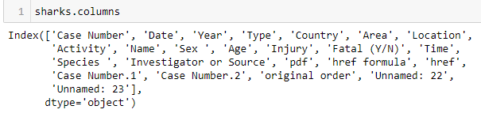



2. Pre-analysis
2.1 Which observations are needed?

Slide 4



2.3 Drop N/A & Drop Duplicates
Initial stage
After drop N/A
After drop Duplicates

Slide 5
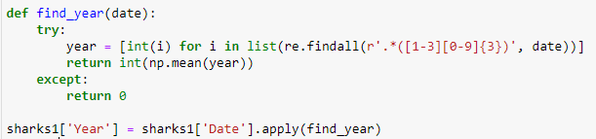
3. Columns analysis and cleaning
3.1 Analysis Date & Year observations
Convert the date field to a string
Year modification to the right format
Year filtering from 2000

Slide 6
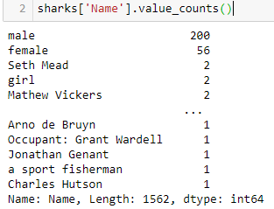
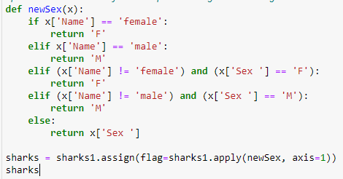

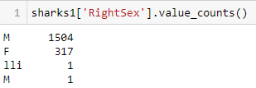
3.2 Analysis Name & Sex observations
Analysis inconsistencies & function to solve it
Removing invalid cases and replacing for correcting information

Slide 7
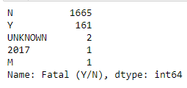
3.3 Analysis Fatal observations
Renaming column and dropping wrong results

Slide 8
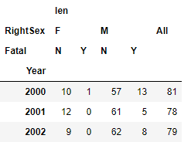

4. Pivot table and summary
Creating the pivot table
Converting the results into percentatges

Slide 9
5. Conclusion
Which is the average probability from 2000 per sex, that if a shark attacks you, will be fatal?
If you are a Female the average probability is of a 1%.
If you are a Male the average probability is of an 8%.

